Slide 1
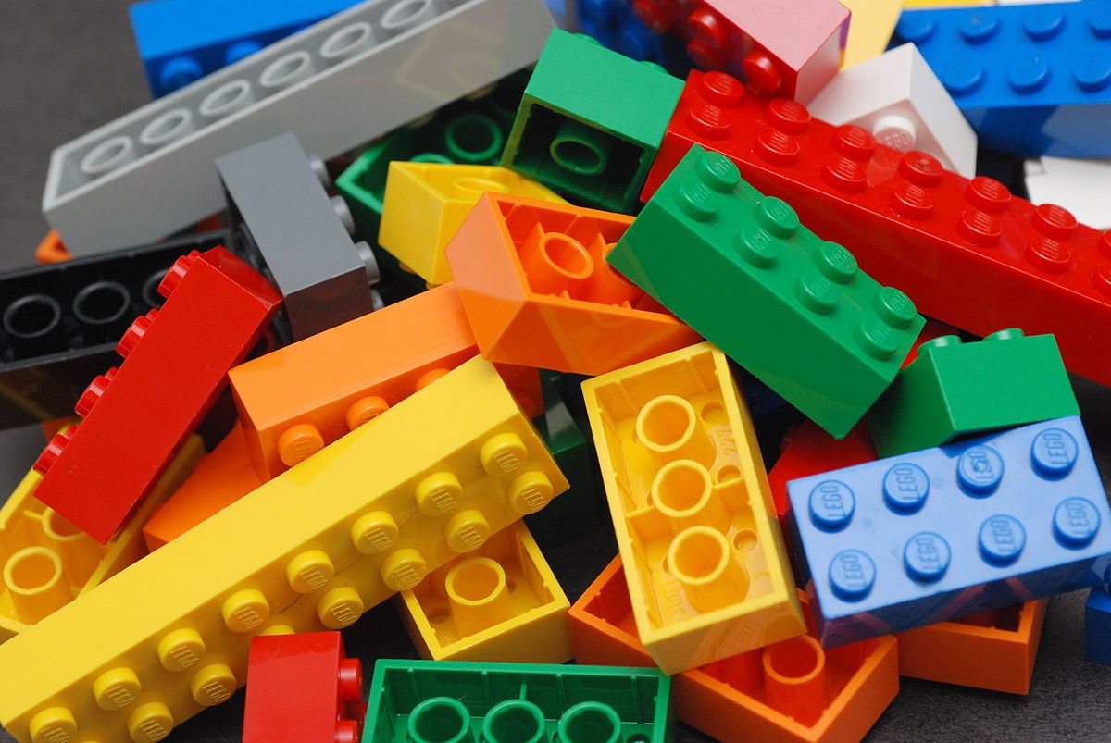
You will need 5 lego pieces for today’s assembly
Wednesday Assembly
Notes:
Make something and show it to the camera
What do we notice
Anyone's similar, anyone's different?
Anyone's the same, exactly?
All lego, all 5 bits
All have lots in common but can feel different
We are all different – but we are all the same
How to manage when life changes?

Slide 2
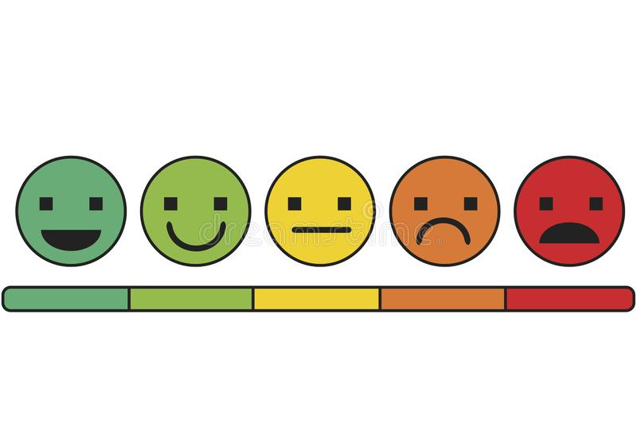
Notes:
How do you feel –
Happy, sad excited worried, nervous, ok

Slide 3
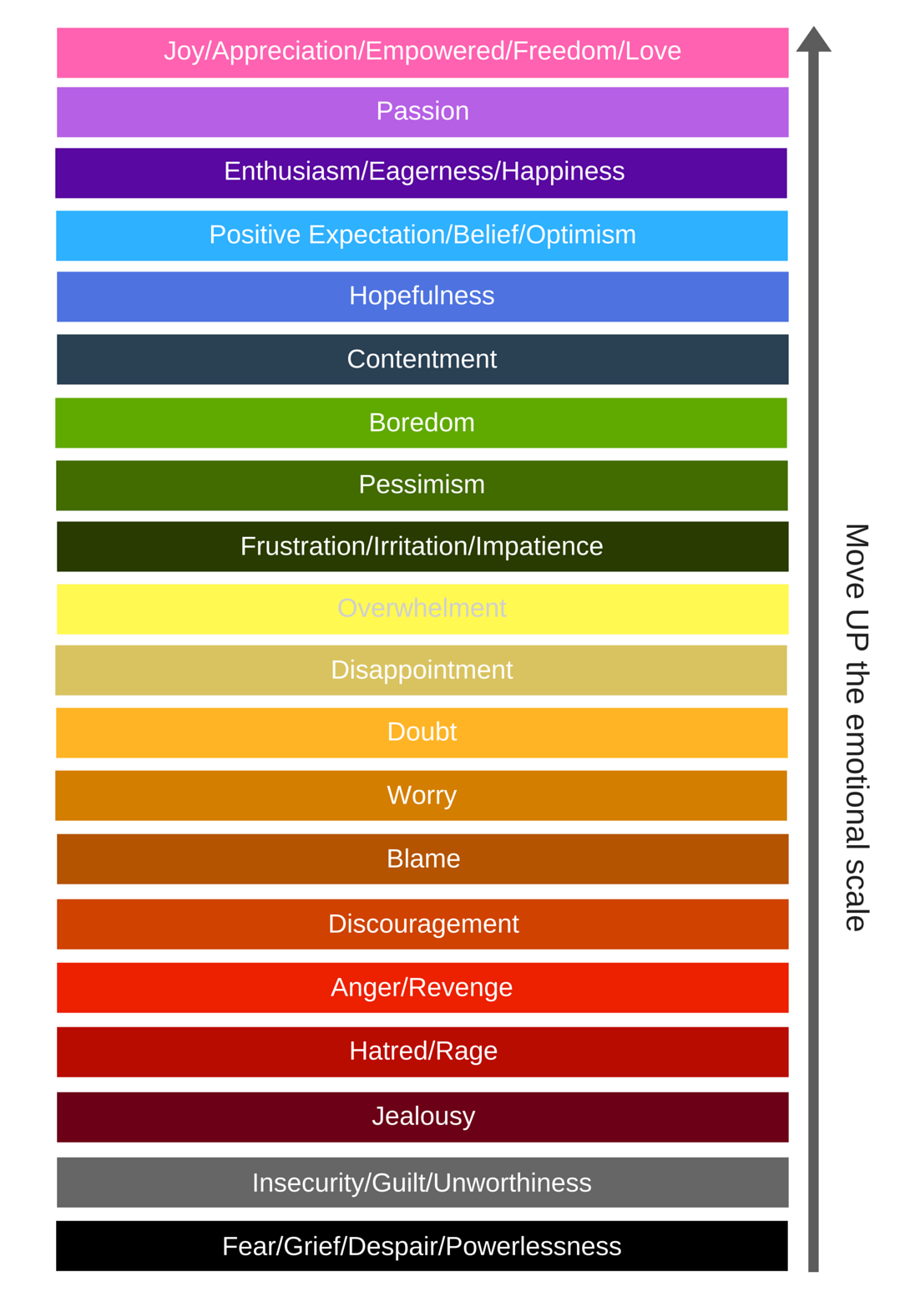
Notes:
How do you feel – what wo

Slide 4
Practise noticing your emotions
Notes:
I feel ……..
When you notice how you feel, you can do something about it – or enjoy it more!
Think about what could move you up on the scale

Slide 6
Please join in with the Emscote prayer
Dear God
Thank you for everyone in Emscote School
Help us to feel happy and safe here
May we always try our best
And help us to show kindness and care to everyone we meet.
Amen

Slide 7
You will need 5 lego pieces for today’s assembly
Friday Assembly
Notes:
Ready to share how you felt in a situation ?

Slide 8
Notes:
Next session

