Slide 2
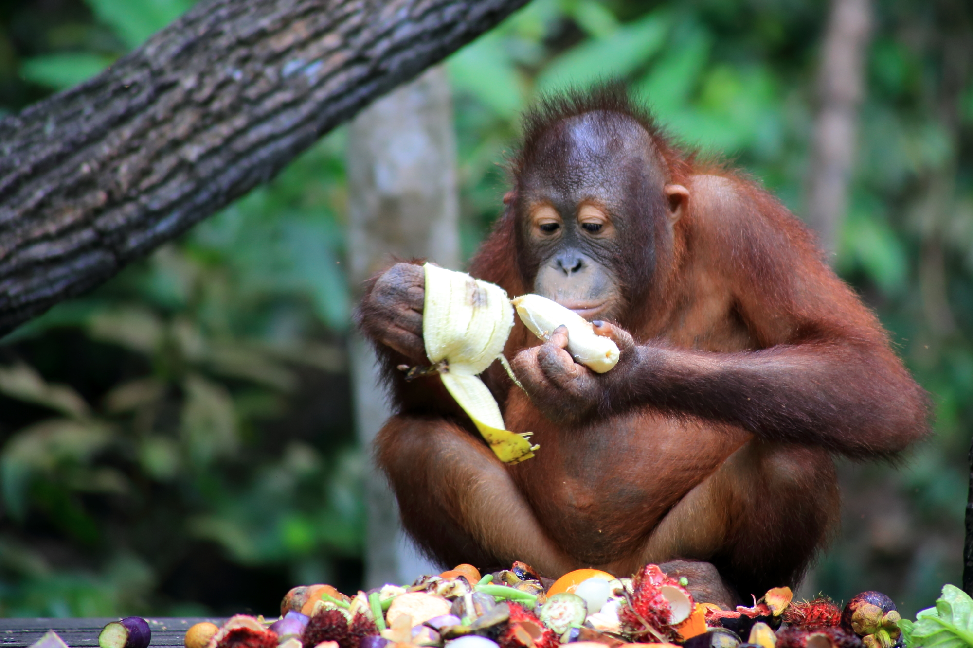
Daily News
13th November 2018
Environment x UK News x
Banned Ad
A Christmas advert has been banned for being too political! It showed how the rainforest is being damaged by palm oil production.
Iceland, a supermarket company in the UK, decided to stop using palm oil in their products. They released an animated advert to tell people about this.
However, the advert was banned! This is because there are strict rules about adverts which give a political message.
Palm oil is used in lots of different foods and products. It’s made from the fruit of palm trees and it’s quite easy to make a lot of oil quickly.
However, it has been linked to deforestation. Large areas of rainforests are being burnt to create room for palm trees.
This is destroying the homes of many endangered animals, such as the orangutan.
Read the full article online here.
Photo: An orangutan living in the rainforest.
“Treasure” by [Joe Hunt] is licensed under CC BY 2.0
What is palm oil?
Why is palm oil controversial?
Should we buy products with palm oil in them?
Notes:
Teacher Note - Please do not let the next video automatically play at the end of the clip. Please check the content in this link, including any comments, is suitable for your educational environment before showing. Twinkl accepts no responsibility for the content of third party websites.

Slide 4
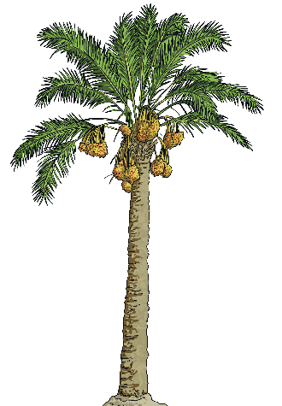
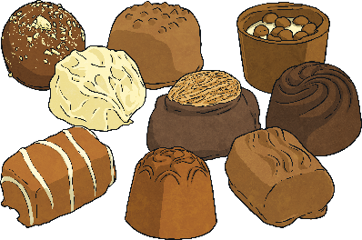
What Is Palm Oil?
fruit
naturally
different
Palm oil is a vegetable oil made from the fruit of African palm trees.
Palm oil is found in lots of different food and goods, such as ice cream, chocolate and even shampoo or lipstick!
These trees grow naturally in West Africa but are now mostly grown in Indonesia and Malaysia.
It used to be hard to find out if palm oil had been used as an ingredient in food and other products.
Palm oil is quite cheap to make. It can be made quickly and palm trees produce a lot of palm oil.
Look at labels to find which food or products have palm oil in them.
Now, companies have to say on the label if a product has palm oil in it.
How is palm oil made?

Slide 6
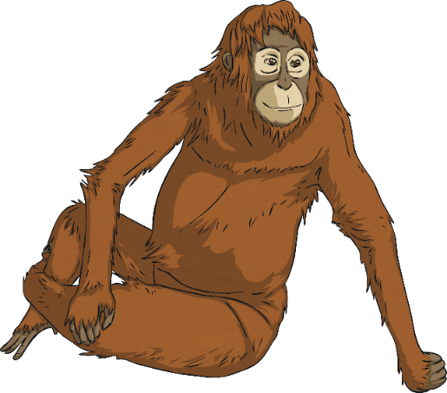
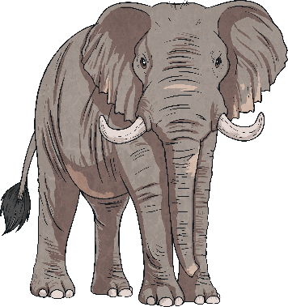
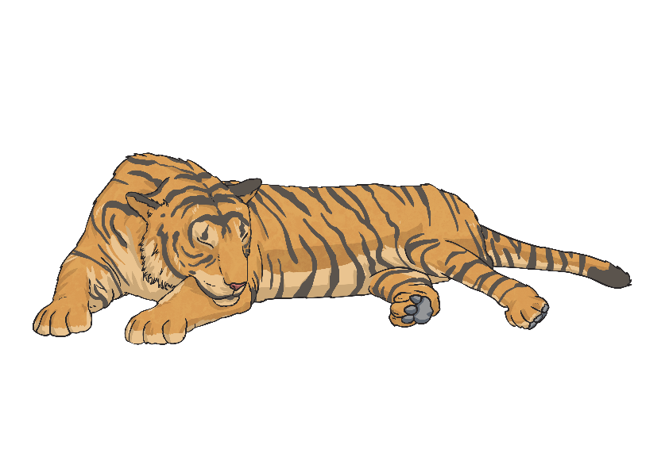
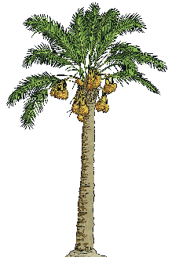
Why Is Palm Oil Controversial?
group
increases
breathe
Palm oil is controversial because it is linked to the deforestation of the world’s rainforests.
This has destroyed the homes and habitats of orangutans, elephants and tigers.
Large areas of rainforests are being burnt down to make space for palm tree planting.
The smoke caused by burning trees also increases air pollution.
Write a sentence explaining why palm oil is controversial.
Greenpeace, a group concerned with protecting rainforests, say that an area the size of a football pitch is cut down every 25 seconds in Indonesia.
Rainforests also produce a lot of oxygen which we need to breathe.
Which animals live in the rainforest?

Slide 8
Should We Buy Products with Palm Oil in Them?
decided
often
businesses
Iceland have decided not to use any palm oil in any of their products.
This means that other options might be worse.
Instead, many businesses use sustainable palm oil.
They think the use of palm oil often harms rainforests, animals and the environment.
This is palm oil which is grown and made in a way which doesn’t harm the rainforest.
However, others disagree. They say that palm oil creates jobs for people living in poorer areas.
Wildlife charity WWF keeps track of which businesses are using sustainable palm oil.
Palm oil also needs less space to make oil than any of the other options.
Research arguments for and against palm oil.
What do you think?

Slide 10
Glossary
Word | Definition
production | The making of something from materials.
animated | A film, show or video made using drawings put together to create movement.
deforestation | The clearing of a wide area of trees.
endangered | An animal species which is in danger of being wiped out.

